Slide 1

Université de Mostaganem — Dr. Madani BELACEL
ICT Tutorial 03 — Windows: Interface, Files and Personalization
Module TIC — Dr. BELACEL Madani
Université de Mostaganem — MCB

Slide 2
Université de Mostaganem — Dr. Madani BELACEL
🎯 Objectifs pédagogiques
• Comprendre les concepts clés
• Appliquer les compétences
• Évaluer les technologies

Slide 3
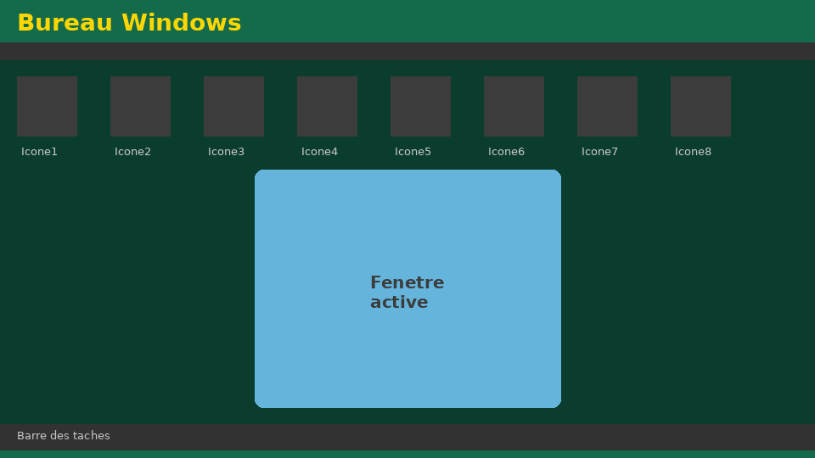
Université de Mostaganem — Dr. Madani BELACEL
📋 Plan du cours
• Exercise 1 — Interface identification(15 min)
• Exercise 2 — Creating a tree(18 min)
• Exercise 3 — Professional naming(15 min)
• Exercise 4 — Keyboard shortcuts(15 min)
• Exercise 5 — Safety(17 min)

Slide 4
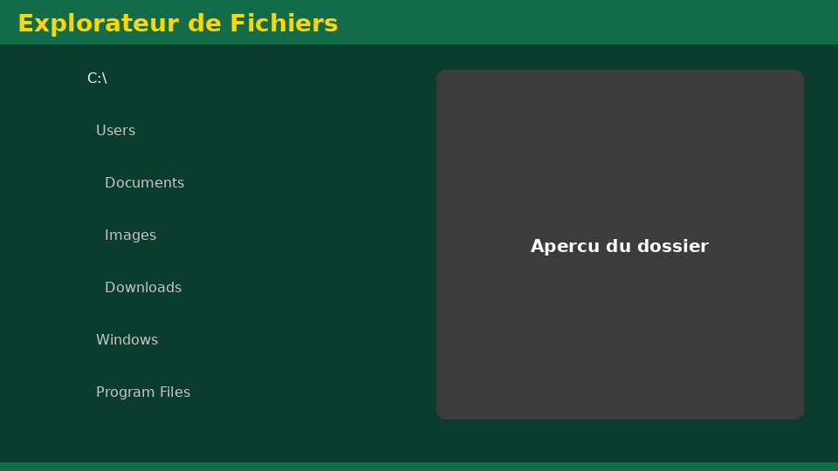
Exercise 1 — Interface identification(15 min)
• Statement:In a screenshot, identify 8 elements of the Windows Desktop.
• Fixed:Desktop, icons, taskbar, start menu, notification area, active window, trash, search bar.
Université de Mostaganem — Dr. Madani BELACEL

Slide 5
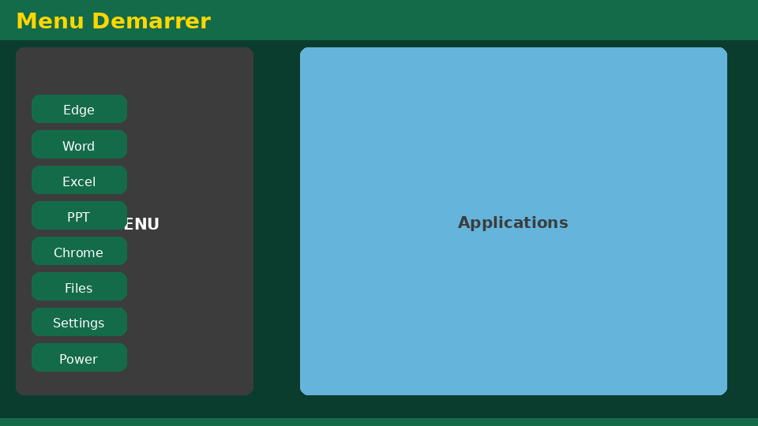
Exercise 2 — Creating a tree(18 min)
• Statement:Create the L1 Languages ​​tree in Documents (Courses, Tutorials, Exams, Projects, Saves).
• Corrected:Structure conforms to the course convention with dated subfolders.
Université de Mostaganem — Dr. Madani BELACEL

Slide 6
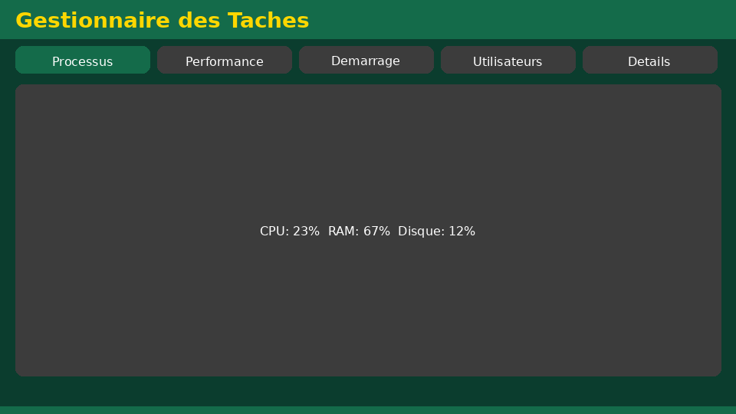
Exercise 3 — Professional naming(15 min)
• Statement:Rename 5 files according toYYYY-MM-DD_Module_Type_Name_vX.ext.
• Corrected:Ex.2026-06-04_TIC_TD3_BELACEL_v1.docx— no prohibited characters.
Université de Mostaganem — Dr. Madani BELACEL

Slide 7
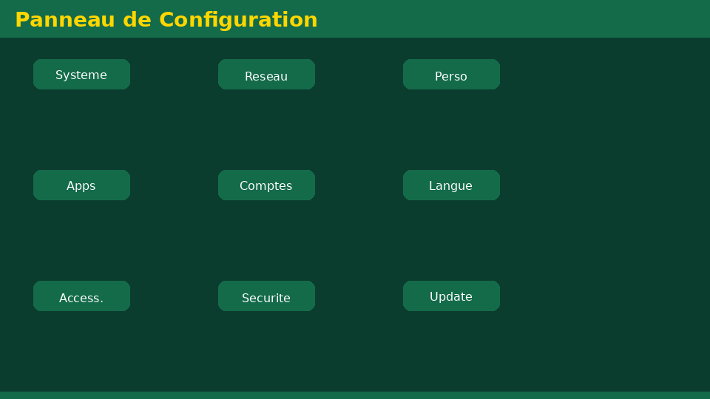
Exercise 4 — Keyboard shortcuts(15 min)
• Statement:Copy, cut, paste, cancel and lock session by keyboard only.
• Fixed:Ctrl+C, Ctrl+X, Ctrl+V, Ctrl+Z, Windows+L.
Université de Mostaganem — Dr. Madani BELACEL

Slide 8
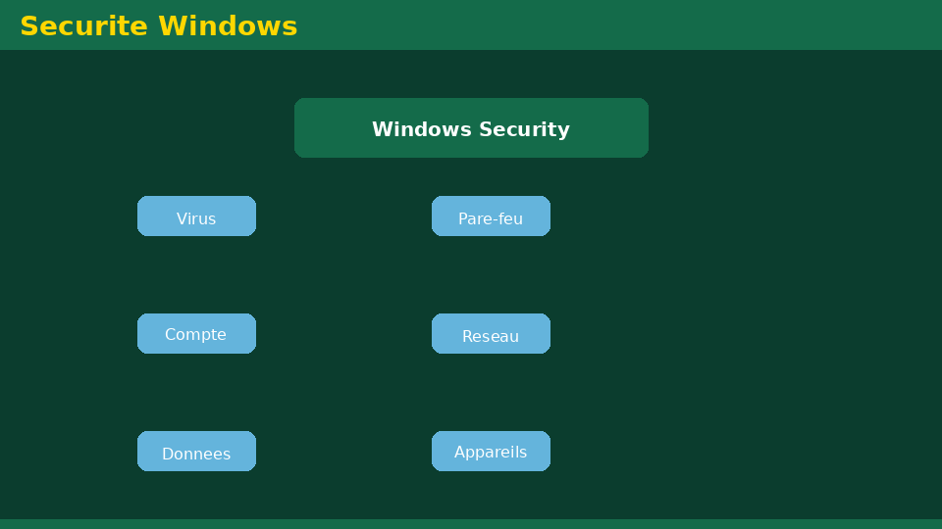
Exercise 5 — Safety(17 min)
• Statement:List 6 important safety rules for a student.
• Fixed:Session lock, 3-2-1 backups, updates, antivirus, USB caution, strong passwords.
Université de Mostaganem — Dr. Madani BELACEL

Slide 9
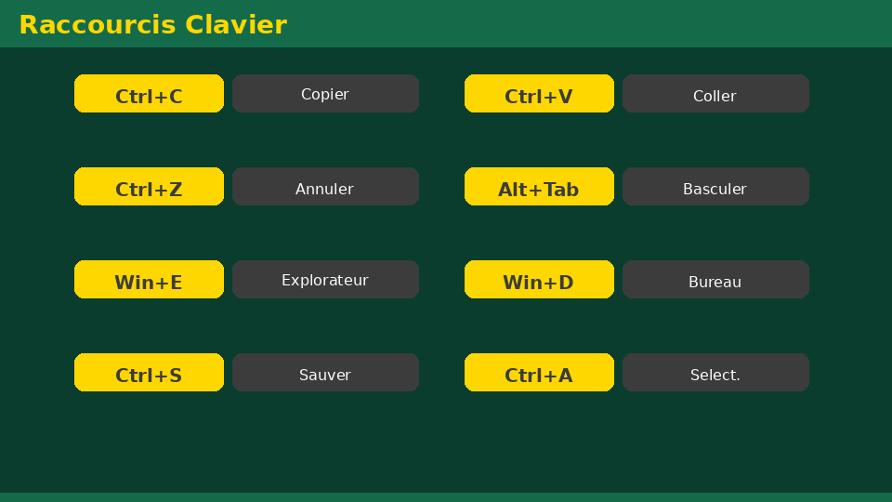
• Statement:In a screenshot, identify 8 elements of the Windows Desktop.
• Statement:Create the L1 Languages ​​tree in Documents (Courses, Tutorials, Exams, Projects, Saves).
• Statement:Rename 5 files according toYYYY-MM-DD_Module_Type_Name_vX.ext.
📝 Points clés à retenir
Université de Mostaganem — Dr. Madani BELACEL

Slide 10
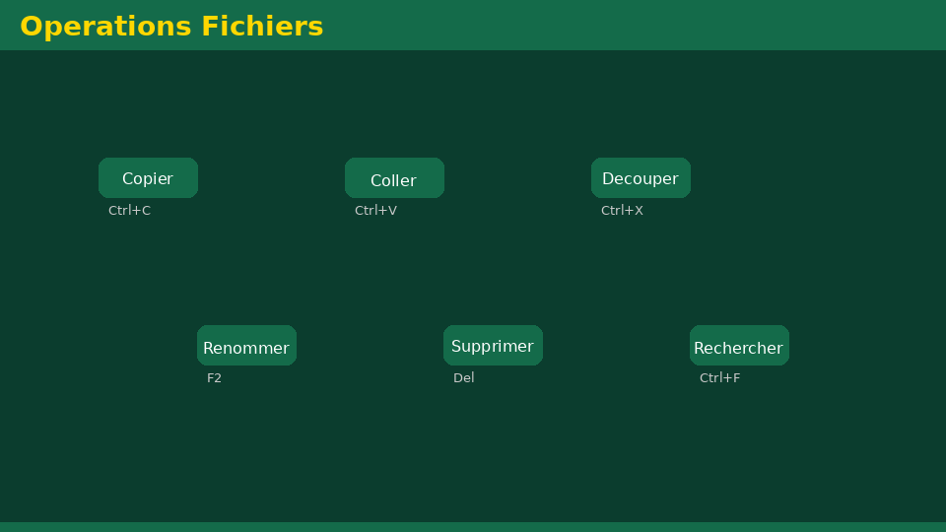
• Statement:In a screenshot, identify 8 elements of the Windows Desktop.
• Statement:Create the L1 Languages ​​tree in Documents (Courses, Tutorials, Exams, Projects, Saves).
• Statement:Rename 5 files according toYYYY-MM-DD_Module_Type_Name_vX.ext.
📝 Points clés à retenir
Université de Mostaganem — Dr. Madani BELACEL

Slide 11
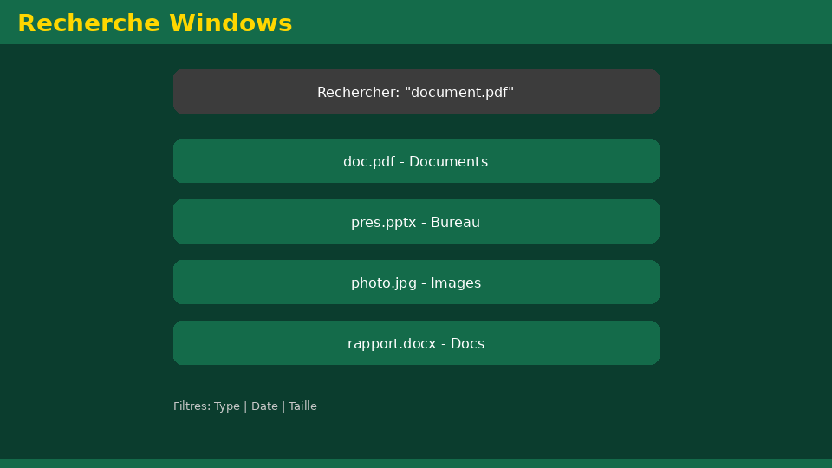
• Statement:In a screenshot, identify 8 elements of the Windows Desktop.
• Statement:Create the L1 Languages ​​tree in Documents (Courses, Tutorials, Exams, Projects, Saves).
• Statement:Rename 5 files according toYYYY-MM-DD_Module_Type_Name_vX.ext.
📝 Points clés à retenir
Université de Mostaganem — Dr. Madani BELACEL

Slide 12
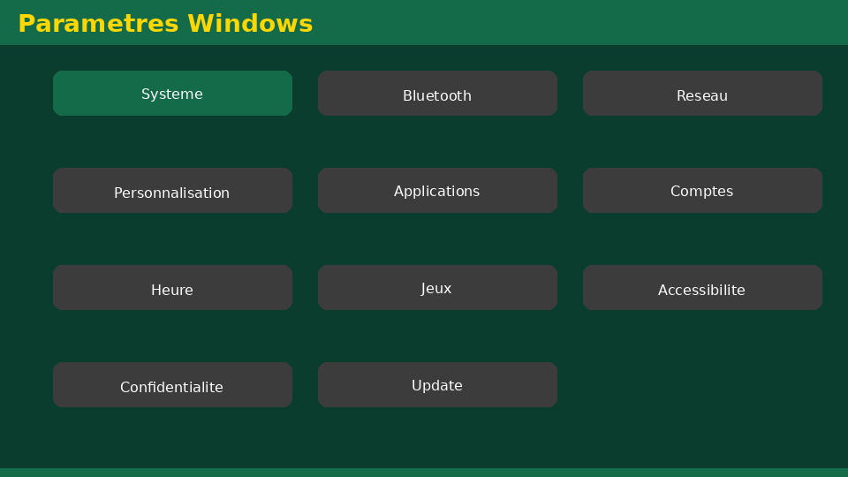
• Statement:In a screenshot, identify 8 elements of the Windows Desktop.
• Statement:Create the L1 Languages ​​tree in Documents (Courses, Tutorials, Exams, Projects, Saves).
• Statement:Rename 5 files according toYYYY-MM-DD_Module_Type_Name_vX.ext.
📝 Points clés à retenir
Université de Mostaganem — Dr. Madani BELACEL

Slide 13
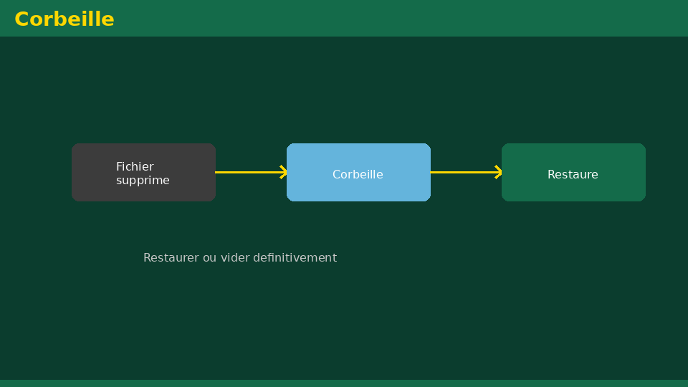
Université de Mostaganem — Dr. Madani BELACEL
📝 Points clés à retenir
• Statement:In a screenshot, identify 8 elements of the Windows Desktop.
• Statement:Create the L1 Languages ​​tree in Documents (Courses, Tutorials, Exams, Projects, Saves).
• Statement:Rename 5 files according toYYYY-MM-DD_Module_Type_Name_vX.ext.
• Statement:Copy, cut, paste, cancel and lock session by keyboard only.
• Statement:List 6 important safety rules for a student.

Slide 14
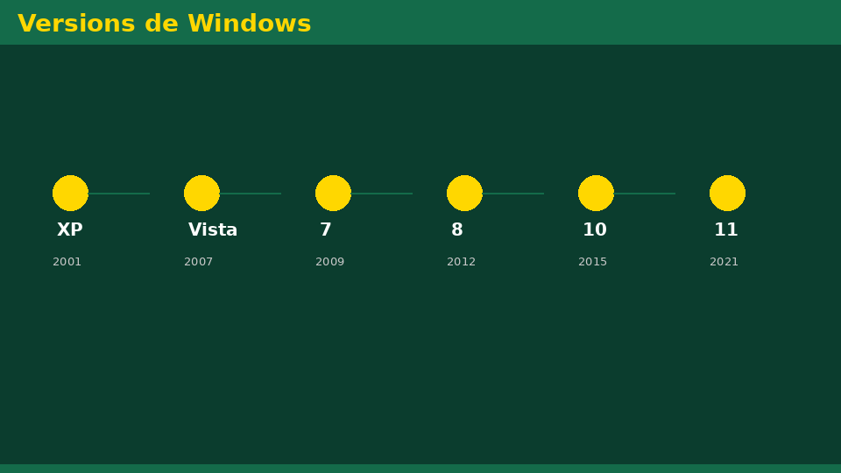
Université de Mostaganem — Dr. Madani BELACEL
✏️ Exercices d'application
• Définir les concepts principaux du cours
• Identifier les applications pratiques
• Résoudre les exercices du TD
• Synthétiser les points clés en un paragraphe
• Préparer une courte présentation orale

Slide 15
Université de Mostaganem — Dr. Madani BELACEL
🎓 Conclusion
Dr. BELACEL Madani Maître de Conférences B Université de Mostaganem madani.belacel@univ-mosta.dz

